Slide 1
Singular Value Decomposition
Hung-yi Lee

Slide 2
Outline
Diagonalization can only apply on some square matrices.
Singular value decomposition (SVD) can apply on any matrix.
Reference: Chapter 7.7

Slide 3
SVD
Any m x n matrix A
m x n
m x m
m x n
n x n
A
U
∑
V^{T}
Orthonormal Set
=
Orthonormal Set
Diagonal
Independent
Independent
The diagonal entries are non-negative

Slide 4
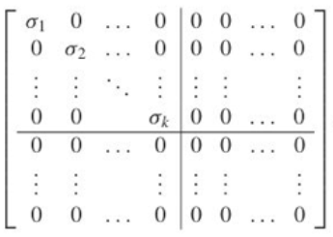


SVD
(We can exchange some rows and columns to achieve that)
Any m x n matrix A
m x n
m x m
m x n
n x n
A
U
∑
V^{T}
Independent
=
Independent
Diagonal
What is the rank of A?
If A is a m x n matrix, and B is a n x k matrix.
$$Rank\left(AB\right)≤min\left(Rank\left(A\right),Rank\left(B\right)\right)$$
If B is a matrix of rank n, then
$$Rank\left(AB\right)=Rank\left(A\right)$$
If A is a matrix of rank n, then
$$Rank\left(AB\right)=Rank\left(B\right)$$

Slide 5
SVD
Any m x n matrix A
m x n
m x m
m x n
n x n
A
U
∑
V^{T}
Independent
=
Independent
Diagonal
m x n
m x k
k x k
k x n
A
U₁
∑’
V₁^{T}
=

Slide 6



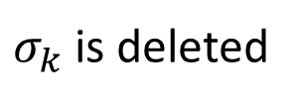

SVD
$$σ_{1}≥σ_{2}≥⋯≥σ_{k}>0$$
$$σ_{k−1}$$
$σ_{k}$ is deleted
Any m x n matrix A
m x n
m x m
m x n
n x n
A
U
∑
V^{T}
Independent
=
$$≠$$
Independent
Diagonal
What is the rank of A’?
m x n
m x (k-1)
(k-1) x (k-1)
(k-1) x n
k-1
A’
U₁
∑’
V₁^{T}
=
A’ is the rank k-1 matrix minimizing $\left\|A−B\right\|$
Notes:
http://mathworld.wolfram.com/FrobeniusNorm.html

Slide 7
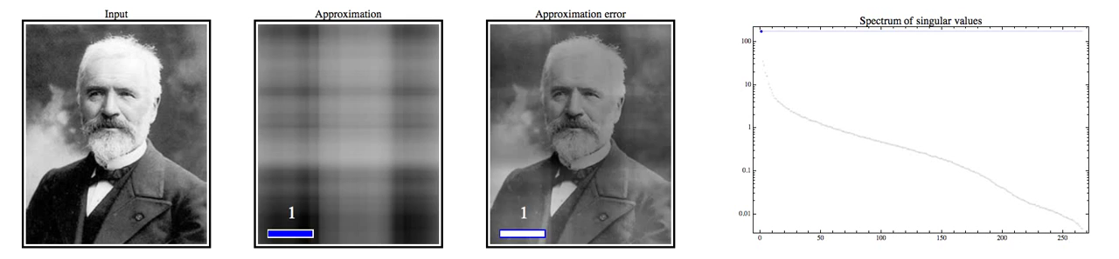
Low rank approximation using the singular value decomposition
https://www.youtube.com/watch?v=pAiVb7gWUrM

Slide 8
https://www.youtube.com/watch?v=fKVRSbFKnEw

Slide 9
Thank You for Your Attention

Slide 10
https://www.youtube.com/watch?v=R9UoFyqJca8

